Slide 1
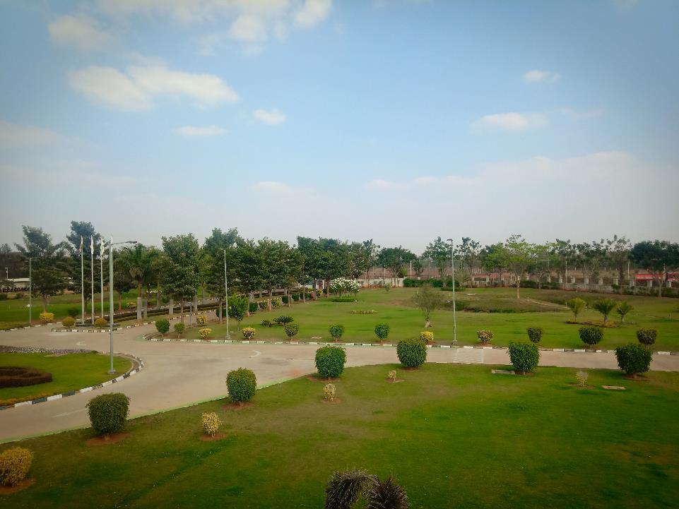
MUSASHI AUTO PARTS INDIA PVT LIMITEd
HORIZON
WELCOME
YOU ALL MIQC – 2018-19
No Limitations For Improvements……….
Notes:
All: First saying NAMASTHE
Sajin: We ARE FROM MUSASHI AUTO PART BLR PLANT. WELCOME YOU ALL FOR THE NH CIRCLE PRESENTATION.
WE ARE TEAM (ALL) HORIZON

Slide 2


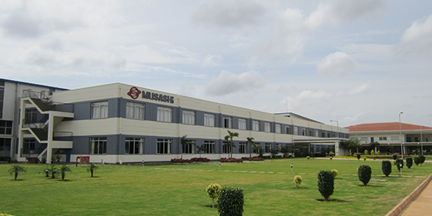












GLOBAL NETWORK
Global network makes optimal production and
supply system achievable. (30 Affiliates in 13 countries)
MUSASHI AUTO PARTS BENGALURU
6
5
EU
9 bases
Asia
16 bases
America
5 bases
: Musashi
30 production bases in global
: HAY Group
Notes:
PLANT EXPLAINATION BY SAJIN

Slide 3





























OUR CUSTOMERS
Europe
North America
Japan
Asia
South America
Notes:
CUSTOMER INTRODUCTION BY SAJIN

Slide 4
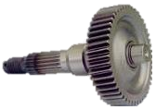
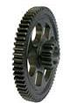
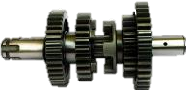
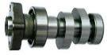
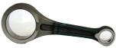
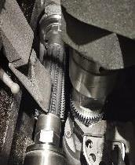
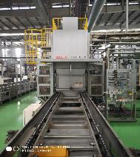
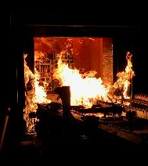
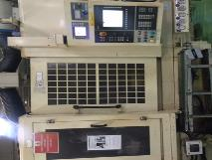
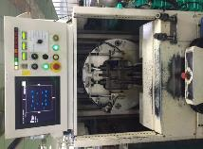
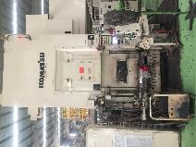
PLANT INTRODUCTION
WE MANUFACTURE
MOTOR CYCLE TRANSMISSION
SCOOTER TRANSMISSION
ENGINE GEAR
CAM SHAFT
CONNECTING ROD
KICK ASSY
OUR FACILITY
FORGING
GEAR CUTTING
HEAT TREATMENT
GRINDING
ASSEMBLY
WE WERE IN OPERATION SINCE 2013
Notes:
SAJIN: We manufacture
MANOHAR: Motorcycle transmission
PRAMOD: Scooter
PRAVEEN: Engine gear
MANOHAR: Cam shaft
PRAMOD: Connecting rod
PRAVEEN: Kick assembly
SAJIN: Our facilities are
MANOHAR: Forging
PRAMOD: Gear cutting
PRAVEEN: Heat treatment
MANOHAR: grinding
PRAMOD: Assy
SAJIN: We were in operation since 2013

Slide 5
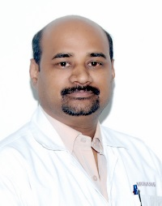
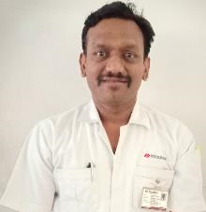
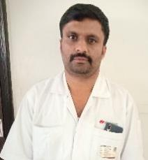
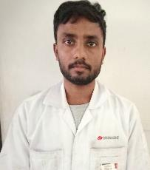
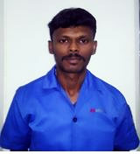
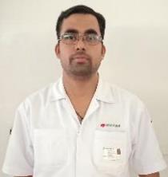
TEAM INTRODUCTION
HORIZON
TOTAL MEMBERS : 6 PERSON
NO OF MEETINGS : 5
TOTAL ATTENDANCE : 91%
UDAYKUMAR HOSUR
STRENGTH: GIVING IDEAS
SAJIN ( Prod.)
STRENGTH: MACHINING
SHIVKUAMR ( PROD )
STRENGTH: PROGRAMMING
ARUN (PROD)
STRENGTH: PART SETTING
VIGNESH (MAINT)
STRENGTH: TOOLING
BHASKAR ( QA)
STRENGTH: SHARING INFORMATION
OUR STRENGTH IS GEAR CUTTING
Notes:
SAJIN : TEAM INTRODUCTION OF UDAY SAN AND THE MEETING EXPLAINATION
ALL SELF INTRODUCTION
BHASKAR : MEMBER INTRODUCTION AND SELF

Slide 6

ACTIVITY SCHEDULE PLANNING
CIRCLE NAME: HORIZON
FACILITATOR:- UDAY SAAN
1.SAJIN
2. BHASKAR
3. SHIV KUMAR
4. VIGNESH
5. ARUN
PROJECT:- TCE REDUCTION
START MONTH;- NOV-18-1W
END MONTH:- JAN-19 4W
MEMBERS
Meeting time every Friday 3 to 4 pm
NO OF PROJECTS COMPLETED:-1
SL NO | ITEM | PDCA | RESP | PLAN / ACTUAL | N0V-18 |  |  |  | DEC-18 |  |  |  | JAN-19
 |  |  |  |  | 1W | 2W | 3W | 4W | 1W | 2W | 3W | 4W | 1W | 2W | 3W | 4W
1 | SELECTION OF THE THEME | PLAN | TEAM | PLAN
 |  |  |  | ACTUAL
2 | GRASP THE CURRENT SITUATION & SETTING THE GOAL | PLAN | TEAM | PLAN
 |  |  |  | ACTUAL
3 | DRAWING THE ACTION | PLAN | TEAM | PLAN
 |  |  |  | ACTUAL
4 | ANALYSIS OF THE RELAVENT FACTORS | DO | TEAM | PLAN
 |  |  |  | ACTUAL
5 | EXAMINATION & IMPLEMENTATION OF COUNTERMEASURES | DO | TEAM | PLAN
 |  |  |  | ACTUAL
6 | CONFIRMATION OF THE EFFECTS | CHECK | TEAM | PLAN
 |  |  |  | ACTUAL
7 | STANDARDIZATION | ACT | TEAM | PLAN
 |  |  |  | ACTUAL
Notes:
SAJIN: THIS IS OUR ACTIVITY PLAN.

Slide 7

THEME SELECTION
Notes:
SAJIN: LETS IDENTIFY THE AREAS FOR IMPROVEMENTS.

Slide 8
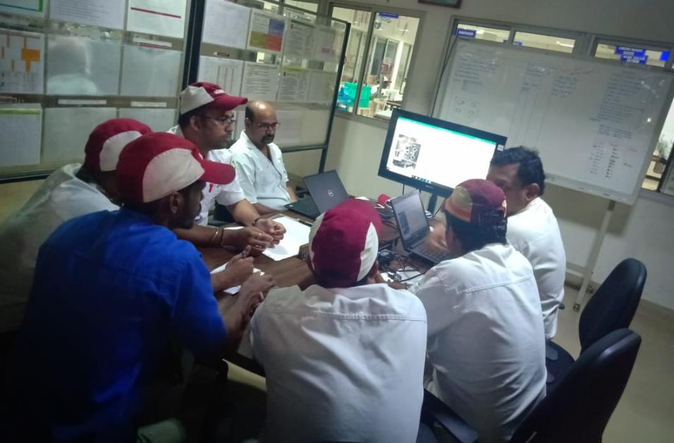
SELECTION OF THE THEME
OEE IMPROVEMENT
5S IMPROVEMENT
PRODUCTIVITY IMPROVEMENT
REWORK REDUCTION
REJECTION REDUCTION
CAPACITY IMPROVEMENT
Notes:
SAJIN :LETS EVALUATE THE PROBLEM BY KJ METHOD

Slide 9
EVALUATION BY KJ METHOD
 | SERIOUSNESS OF THE NEED FOR AN IMPROVEMENT |  |  | CIRCLE CAPABILITY |  |  | APPLICATION OF QC TOOLS | TOTAL EVALUATION POINTS | GRAPH OF EVALUATION POINTS
 | DEGREE OF IMPORTANCE | URGENCY | ECONOMC FACTOR | CAN EVERY ONE PARTICIPATE | CAN CIRCLE SOLVE PROBLEM BY THEMSELVES | CAN FINISH WITH IN THE TARGET TIME
QUALITY
PRODUCTIVITY | ◎ |  |  |  | ◎ | ◎ | ◎
COST
DELIVERY | ◎ | ◎
◎
5 POINTS
EVALUATION CRITERIA
3 POINTS
PROBLEM POINT
1 POINT
◎
◎
◎
◎
◎
◎
33
◎
31
◎
21
◎
23
PROBLEM EVALUATION BY KJ METHOD
Notes:
REWORK HAS GOT MAXIMUM POINTS SO WE SELECT REWORK FOR IMPROVEMENTS

Slide 10
WHAT ARE THE QUALITY PROBLEMS
MODEL MIXUP
REJECTION
REWORK
FITTMENT ISSUE
DELIVERY DELAY
SAFETY ISSUE
SINCE REJECTION IS HIGH CONSIDERD, REJECTION ANALYSIS ON PRIORITY.

Slide 11
TYPES OF DEFECTS LEADS TO REJECTION
RUST PARTS
ID OVER SIZE
TEETH DENT & DAMAGE
SPLINE DENT
FACE UNCLEAR
OBD U/S
TCE
FACE R/O
SPLINE DAMAGE
PCD R/O
CUTTER MARK
ID O/S & OD U/S
Notes:
SAJIN : WHAT ARE THE MAJOR REWORK IN THE LINE

Slide 12
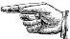
REJECTION DETAILS GEAR A SECTION
REJECTION DETAILS OF THE GEAR A SECTION
COMPONENT | UOM | Jun-18 | Jul-18 | Aug-18 | Sep-18 | Oct-18 | Nov-18 | AVG QTY & %
GEAR COUNTER | QTY | 732 | 779 | 930 | 189 | 618 | 650 | 650
 | % | 0.49% | 0.45% | 0.60% | 0.13% | 0.45% | 0.59% | 0.45%
GEAR C2 -K 55 | QTY | 22 | 56 | 13 | 7 | 23 | 3 | 21
 | % | 0.29% | 0.21% | 0.23% | 0.27% | 0.23% | 0.44% | 0.28%
GEAR -C4 -K 55 | QTY | 141 | 65 | 66 | 112 | 83 | 76 | 91
 | % | 0.29% | 0.24% | 0.24% | 0.19% | 0.30% | 0.34% | 0.27%
GEAR FINAL KWP | QTY | 625 | 390 | 334 | 295 | 342 | 338 | 387
 | % | 0.32% | 0.14% | 0.13% | 0.28% | 0.23% | 0.39% | 0.25%
GEAR - M3 K55 | QTY | 116 | 98 | 136 | 81 | 126 | 63 | 103
 | % | 0.37% | 0.22% | 0.19% | 0.19% | 0.22% | 0.24% | 0.24%
GEAR PKS -K 55 | QTY | 135 | 79 | 109 | 128 | 89 | 62 | 100
 | % | 0.09% | 0.22% | 0.05% | 0.02% | 0.10% | 0.02% | 0.09%
THE CONTRIBUTION Of GEAR COUNTER = 28.9%
Notes:
BHASKAR : HERE IS THE PART WISE REJECTION DETAILS IN GEAR A SECTION .
THE CONTRIBUTION OF GEAR COUNTER IS 28.9 %
SAJIN : WHAT ARE THE MAJOR DEFECTS IN THE GEAR COUNTER

Slide 13
SECTION WISE REJECTION DETAILS
REJECTION IN GEAR A IS
0.60%
LETS FOCUS ON THE GEAR A FOR REJECTION REDUCTION
Notes:
SAJIN : WHAT ARE THE MAJOR REWORK IN THE LINE

Slide 14
REJECTION DETAILS GEAR A SECTION
TOTAL REJECTION IN THE GEAR A SECTION PART WISE
COMPONENT | Jun-18 | Jul-18 | Aug-18 | Sep-18 | Oct-18 | Nov-18 | TOTAL
GEAR COUNTER | 732 | 779 | 930 | 189 | 618 | 650 | 3898
GEAR FINAL | 625 | 390 | 334 | 295 | 342 | 338 | 2324
GPDN -TVS STAR | 997 | 171 | 119 | 50 | 176 | 330 | 1843
GEAR INTERMEDIATE-WEGO | 374 | 714 | 419 | 182 | 382 | 296 | 2367
GPDN -K14F | 83 | 102 | 96 | 138 | 86 | 133 | 638
GEAR REAR WHEEL-WEGO | 49 | 300 | 76 | 107 | 48 | 78 | 658
GPDN -TVS APACHE | 408 | 125 | 172 | 170 | 72 | 33 | 980
THE CONTRIBUTION Of GEAR COUNTER = 31%
Notes:
PRAMOD: THE MAJOR REWORK WERE FORK TIGHT, OD DENT, BORE U/S & GEAR TEETH DENT. OUT OF WHICH FORK TIGHT IS CONTRIBUTING 48%.
SAJIN: IN WHICH PART FORK TIGHT IS COMIN MORE?
MANOHAR: THE MAJOR PARTS CONTRIBUTING TO FORK TIGHT IS M3,C4,C3,M4 . IN THIS GEAR M3 IS CONTRIBUTING MORE WHICH IS 67%.
SAJIN: LETS SELECT M-3 FOR THE IMPROVEMENTS

Slide 15
REJECTION DETAILS
GEAR COUNTER | Jun-18 | Jul-18 | Aug-18 | Sep-18 | Oct-18 | Nov-18 | TOTAL
TCE OUT | 238 | 439 | 595 | 105 | 153 | 397 | 1927
TEETH DAMAGE | 272 | 176 | 170 | 46 | 113 | 96 | 873
BROACHING SPLINE DAMAGE | 93 | 73 | 31 | 5 | 45 | 17 | 264
OBD U/S |  | 28 | 6 | 1 | 225 |  | 260
ID O/S | 48 | 13 | 31 | 3 | 19 | 62 | 176
DENT & DAMAGE | 22 | 21 | 21 | 5 | 48 | 12 | 129
OD U/S | 17 | 10 | 14 | 3 |  | 46 | 90
THE MAJOR REJECTION IN GEAR COUNTER IS TCE OUT
THE AVREAGE REJECTION PERCENTAGE = 0.29%
Notes:
BHASKAR : HERE IS THE LAST SIX MONTHS DEFECT WISE REJECTION DETAILS OF GEAR COUNTER
TCE MORE IS THE MAJOR DEFECT
YOU CAN SEE THAT THE REJECTION HAS INCREASED FROM

Slide 16

THEME
THEME
GEAR COUNTER TCE OUT REJECTION REDUCTION
TARGET
REDUCING TCE OUT FROM 0.29% TO O.O32%
Notes:
SAJIN: OUR THEME IS & OUR TARGET IS
PRAVEEN: THEME & TARGET ( ALL MEMBER SAY ZERO)

Slide 17

Definition
of the Problem

Slide 18
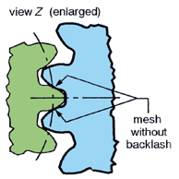


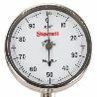
HOW TO CHECK IS TCE
IDEAL CONDITION
DIAL
GEAR
MASTER GEAR
THE DIFFERENCE OF MIN TO MAX ERROR IN ONE ROTATATION OF GEAR
Notes:
SHIVKUMAR : WHAT IS TCE
SAJIN : EXPLAIN THE TCE
HAVE YOU ANALYSED THE REJECTION PART IN DETAILS

Slide 19
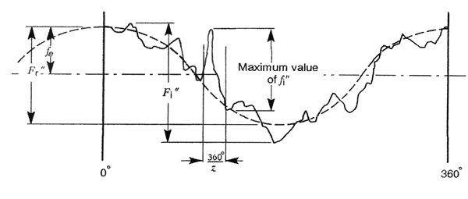
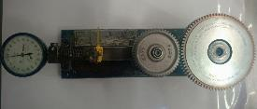
WHAT IS TCE (TOTAL COMPOSITE ERROR)
THE DIFFERENCE OF MIN TO MAX ERROR IN ONE ROTATATION OF GEAR
Notes:
SHIVKUMAR : WHAT IS TCE
SAJIN : EXPLAIN THE TCE
HAVE YOU ANALYSED THE REJECTION PART IN DETAILS

Slide 20
DEFECT PARTS INVESTIGATION
PART | 1 | 2 | 3 | 4 | 5 | 6 | 7 | 8 | 9 | 10
TCE | 0.080 | 0.090 | 0.085 | 0.080 | 0.090 | 0.100 | 0.070 | 0.075 | 0.080 | 0.090
PCD | 0.080 | 0.090 | 0.070 | 0.090 | 0.085 | 0.085 | 0.060 | 0.070 | 0.075 | 0.080
PARALLALISM | 0.070 | 0.075 | 0.080 | 0.080 | 0.075 | 0.070 | 0.065 | 0.080 | 0.060 | 0.070
FACE R / O | 0.060 | 0.072 | 0.086 | 0.072 | 0.068 | 0.080 | 0.062 | 0.073 | 0.065 | 0.062
STRONG CO-RELATION EXISTS FOR TCE IN RELATION TO PCD , PARALLILISM & FACE R/O
Notes:
BHASKAR : I HAVE ANALYSED THE REJECTION PART.
TAKEN 10 TCE OUT PARTS AND CHECKED ALL THE PARAMETERS
BHASKAR : CO RELATED THE PARAMETERS WITH THE TCE

Slide 21
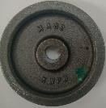
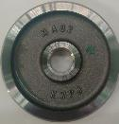
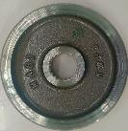
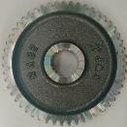

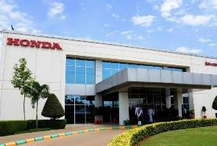
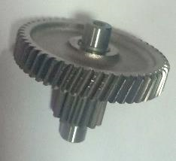
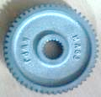
PROCESS FLOW OF GEAR COUNTER
FORGING
TURNING-1
TURNING-2
BROACHING
HOBBING
HMSI -NARASAPURA
SHAVING
HEAT
TREATMENT
ASSEMBLY
INSPECTION
Notes:
MANOHAR: our manufacturing process start from. Forging
PRAMOD: turning-1
PRAVEEN: turning-2
MANOHAR: broaching
PRAMOD: shaping
PRAVEEN: heat treatment
MANOHAR: inspection
PRAMOD: assy
PRAVEEN: OUR BUSSINESS PARTNER IS HONDA
SAJIN: WHERE FORK TIGHT IS GENERATING?
PRAVEEN: TURNING-2
SAJIN: DID WE HAVE THE REWORK DATA?

Slide 22
LETS FOCUS ON TURNING

Slide 23

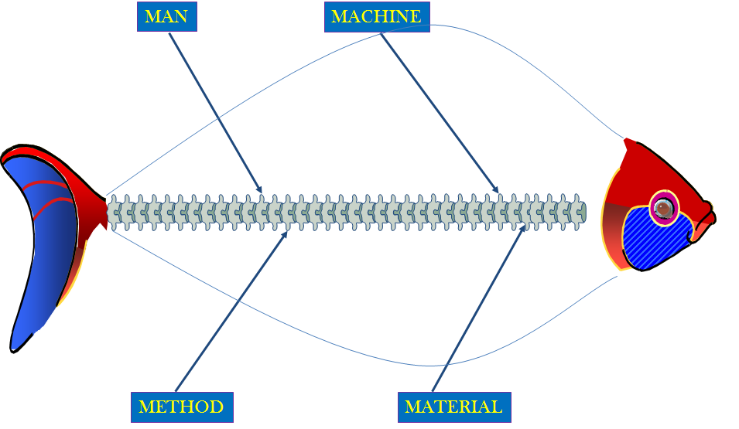
SAKANA NO HONE (FISH BONE)
TCE OUT
COOLENT PIPE POSITION
UN SKILLED ASSOCIATE
HOB ARBOUR R/O
WEAR PART CONDITION
COOLANT PIPE POSITION
VERTICAL TOOL ALIGNMENT
CHUCK R/O SETTING
CUTTER R/O
SEAT CHECK
PART HOLDING DEVICES
FIXTURE R/O
MACHINE BED PARALLISM
NG PART HANDLING
VERTICAL TOOL ALIGNMENT
PART MASTER R/O
TOOL CLAMPING
CUTTER FACE R/O
TAILSTOCK R/O
CUTTING PARAMETERS
INSERT
INSERT WEAR
ID UNDERSIZE
INPUT STOCK VARIATION
GAUGING
TOOL PATH
CHIP EVACUATION
WORK ARBOR DIA
HARDNESS VARIATION
VARIATION AFTER SHAVING
Notes:
SAJIN: THE MAJOR FACTORS RELATED TO MACHINE
MANOHAR: 2 points read
SAJIN: man
PRAMOD: read points
SAJIN: method
PRAVEEN: read all points
SAJIN: there is no cause in material
PRAVEEN: there is no causes in material found
SAJIN: lets du the factor analysis on these problem points

Slide 24
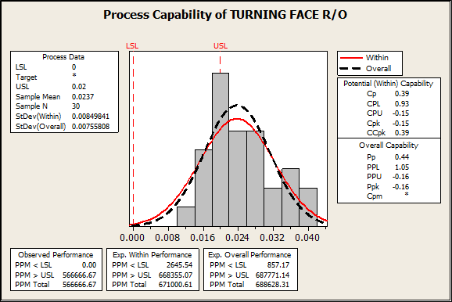


PROBLEM ANALYSIS
SAMPLE TAKEN FROM MASS PRODUCTION PARTS
PROCESS CAPABILITY OF PARALLELISM
Cp = 0.39
Cpk =-0.15
HERE 43% OF PARTS ARE OUT OF THE SPEC. AND Cpk NOT ACHIEVED.
LETS DO THE SAKANA NO HONE ANALYSIS.
Notes:
SAJIN: WHAT IS TCE
BHASKAR : TCE IS MEASURED BY USING GRT
IT IS THE

Slide 25
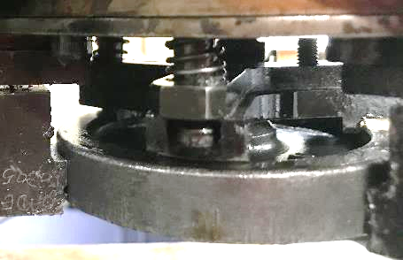
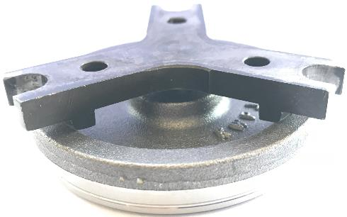
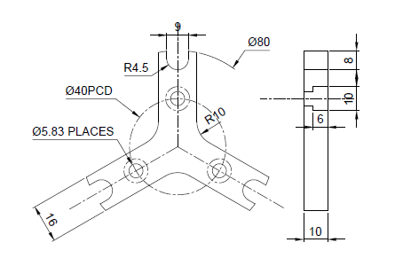
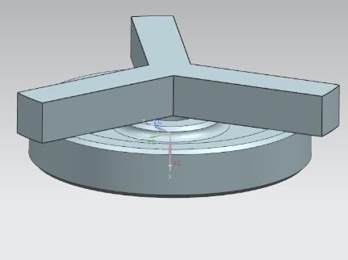
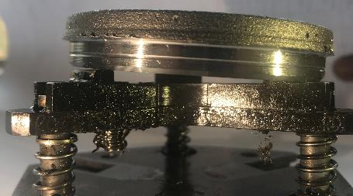
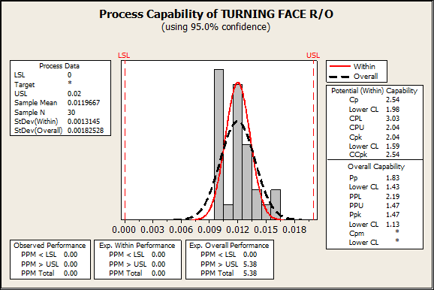
GEMBA VERIFICATION
PUSHER PLATE IS NOT PUSHING THE PART PROPERLY
LETS MODIFY THE PUSHER DESIGN
ONLY THE PUSHER LUG EDGE IS PUSHING THE PART
HERE IS HOW THE MODIFIED PUSHER PUSH THE PART
PUSHER IS CLAMPING THE PART IN THE GROOVE
PUSHER DESIGN IS NG
PROCESS CAPABILITY OF PARALLELISM
Cp =2.54
Cpk =2.04

Slide 26
LETS FOCUS ON BROACHING

Slide 27
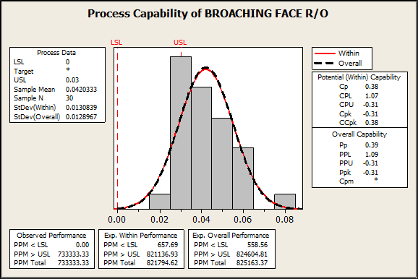
PROBLEM ANALYSIS
SAMPLE AFTER PARALLELISM CORRETION
Cp = 0.38
Cpk = -0.31
HERE 70% OF PARTS ARE OUT OF THE SPEC & Cpk NOT ACHIEVED
LET’S DO THE SAKANA NO HONE ANALYSIS.
Notes:
SAJIN: WHAT IS TCE
BHASKAR : TCE IS MEASURED BY USING GRT
IT IS THE

Slide 28

FACTOR ANALYSIS
SI NO | FACTOR | CONFIRMATION POINTS | INSPECTION CRITERIA | OBSERVATION / IMPROVEMENT POINTS | JUDGE
1
2
3
4
5 |  |  | TOOL ALIGNMENT SHOULD BE WITH IN 0.010 MM
6 | MACHINE | BED PARALLELISM | PARALLELISM TO BE WITH IN 0.010 MM
MATERIAL
HARDNESS VARIATION
HARDNESS SPEC
80 ~ 95 HRB
HARDNESS IS WITH IN SPEC
METHOD
TOOL WEAR
CHECKED FOR THE TOOL WEAR
METHOD
CUTTING PARAMETERS
CHECK PARAMETERS IN PROGRAM
MAN
COOLANT PIPE POSITION
VERIFIED THE COOLENT FLOW AT CUTTING AREA
MACHINE
VERTICAL TOOL ALIGNMENT
Notes:
MANOHAR: Machine: 2 points( all together say….. Ok (loudly with thump show) after saying judgment is……….
PRAVEEN: NEXT VARIATION AFTER SHAPING

Slide 29


FACTOR ANALYSIS
SI NO | FACTOR | CONFIRMATION POINTS | INSPECTION CRITERIA | OBSERVATION / IMPROVEMENT POINTS | JUDGE
1
2
3
4
5 |  |  | TOOL ALIGNMENT SHOULD BE WITH IN 0.010 MM
6 | MACHINE | BED PARALLELISM | PARALLELISM TO BE WITH IN 0.010 MM
MATERIAL
HARDNESS VARIATION
HARDNESS SPEC
80 ~ 95 HRB
HARDNESS IS WITH IN SPEC
METHOD
TOOL WEAR
CHECKED FOR THE TOOL WEAR
NO WEAR FOUND IN THE TOOL
METHOD
CUTTING PARAMETERS
CHECK PARAMETERS IN PROGRAM
ALL PARAMETERS WERE AS PER LOGIC
MAN
COOLANT PIPE POSITION
VERIFIED THE COOLENT FLOW AT CUTTING AREA
COOLANT FLOW NOT OK
MACHINE
VERTICAL TOOL ALIGNMENT
ALIGNMENT FOUND 0.10 MM AND PULL END LOCK FOUND NG
PARALLISM FOUND 0.080
Notes:
MANOHAR: Machine: 2 points( all together say….. Ok (loudly with thump show) after saying judgment is……….
PRAVEEN: NEXT VARIATION AFTER SHAPING

Slide 30
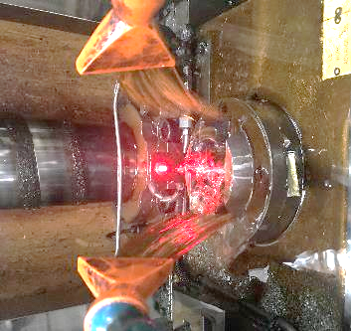
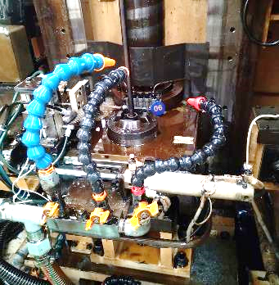
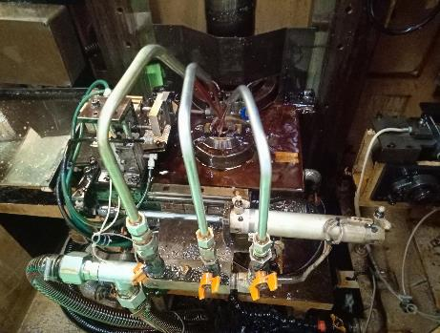
GEMBA VERIFICATION
IDEALLY - THE FLUSHING SHOULD BE ON THE WORK REST TO AVOID CHIP ACCUMULATION
THE FLUSHING PIPES GETTING DISTURBED DURING CONTINIOUS OPERATION
WHAT TO BE DONE
LETS GO FOR PERMANENT ACTION
NEED TO PREVENT THE MOVEMENT OF FLUSHING PIPE
FLEXIBLE PIPES REPLACED WITH METAL PIPES
FIXED METAL PIPES

Slide 31
LETS FOCUS ON
HOBBING

Slide 32
FACTOR ANALYSIS
SI NO | FACTOR | CONFIRMATION POINTS | INSPECTION CRITERIA | OBSERVATION / IMPROVEMENT POINTS | JUDGE
1
2
3
4
5 |  |  | ARBOR DIA SPEC 13.504 ~13.517 MM
6 | METHOD | CHIP EVACUATION | NO CHIP ALLOWED IN PART RESTING AREA
MACHINE
HOB ARBOUR RUNOUT
RUNOUT WITH IN 0.010 MM
FOUND 0.008MM
MACHINE
TAILSTOCK RUNOUT
RUNOUT WITH IN 0.010 MM
FOUND 0.010 MM
METHOD
CUTTING PARAMETERS
CHECK PARAMETERS IN PROGRAM
ALL PARAMETERS WERE AS PER LOGIC
MAN
CUTTER RUNOUT
RUNOUT WITH IN 0.010 MM
FOUND 0.008MM
MATERIAL
WORK ARBOUR DIA
ARBOR DIA FOUND 13.454 MM
CHIPS ACCUMILATED IN PART RESTING AREA
Notes:
MANOHAR: Machine: 2 points( all together say….. Ok (loudly with thump show) after saying judgment is……….
PRAVEEN: NEXT VARIATION AFTER SHAPING

Slide 33
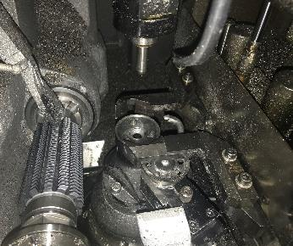
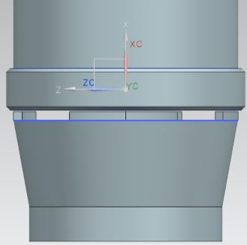
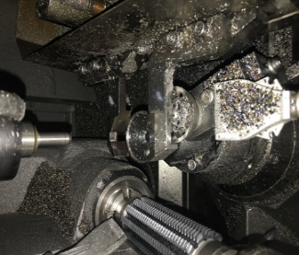
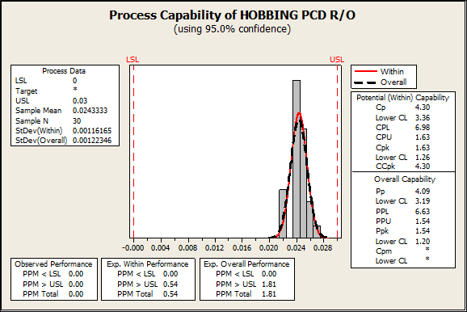
CHIP AT CLAMPING
CHIPS IN FIXTURE
TOP CLAMP
AIR FLUSHING POINTS
CHIPS IN FIXTURE
COMPONENT
AIR FLUSHING POINTS
RESTING FIXTURE
CHIPS ACCUMILATION ELIMINATED
Cp = 4.30
Cpk = 1.63

Slide 34


EFFECT CONFIRMATION
PARALLILISM OUT ELIMINATION
1
2
FACE RUN OUT CORRECTION
PCD R/O ELIMINATION IN HOBBING
3
(47 NOS – 0.06%
(35 NOS – 0.03%
AFTER IMPLIMENTATION ALL THE KAIZENS TCE REJECTION REDUCEED .

Slide 35
ACTIVITY SCHEDULE PLANNING
CIRCLE NAME: HORIZON
FACILITATOR:- UDAY SAAN
1.SAJIN
2. BHASKAR
3. SHIV KUMAR
4. VIGNESH
5. ARUN
PROJECT:- TCE REDUCTION
START MONTH;- NOV-18-1W
END MONTH:- JAN-19 4W
MEMBERS
Meeting time every Friday 3 to 4 pm
NO OF PROJECTS COMPLETED:-1
SL NO | ITEM | PDCA | RESP | PLAN / ACTUAL | N0V-18 |  |  |  | DEC-18 |  |  |  | JAN-19
 |  |  |  |  | 1W | 2W | 3W | 4W | 1W | 2W | 3W | 4W | 1W | 2W | 3W | 4W
1 | SELECTION OF THE THEME | PLAN | TEAM | PLAN
 |  |  |  | ACTUAL
2 | GRASP THE CURRENT SITUATION & SETTING THE GOAL | PLAN | TEAM | PLAN
 |  |  |  | ACTUAL
3 | DRAWING THE ACTION | PLAN | TEAM | PLAN
 |  |  |  | ACTUAL
4 | ANALYSIS OF THE RELAVENT FACTORS | DO | TEAM | PLAN
 |  |  |  | ACTUAL
5 | EXAMINATION & IMPLEMENTATION OF COUNTERMEASURES | DO | TEAM | PLAN
 |  |  |  | ACTUAL
6 | CONFIRMATION OF THE EFFECTS | CHECK | TEAM | PLAN
 |  |  |  | ACTUAL
7 | STANDARDIZATION | ACT | TEAM | PLAN
 |  |  |  | ACTUAL
Notes:
PRAVEEN: THIS IS OUR ACTIVITY PLAN.

Slide 36
SUMMARY
AFTER THE KAIZENS & CORRECTIVE ACTIONS
THE RESULTS
TOTAL SAVING :
0.343 MIL / ANNUM
THE TCE REJECTION HAS BEEN REDUCEED

Slide 37
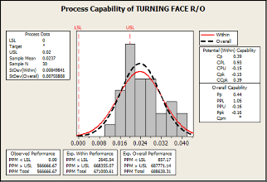
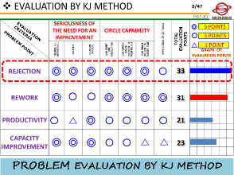



QC TOOLS & TECHNICS USED
We used following QC tools & Techniques for our project
Histogram
KJ METHOD
Cause and Effect Diagram
Brain storming
Graph
Notes:
MANOHAR

Slide 38

IN TANGEBLE BENIFITS
PARAMETER | BENIFITS | REMARK
PRODUCTION | PRODUCTIVITY IMPROVED
QUALITY | REJECTION REDUCED
COST | COST OF QUALITY REDUCED
DELIVERY | ON TIME DELIVERY
SAFTEY | ZERO ACCIDENT
MORAL | OPERATOR FATIGUE REDUCED

Slide 39
THANK YOU
Notes:
BE TOGETHER

